Slide 1
Early Computing

Slide 2
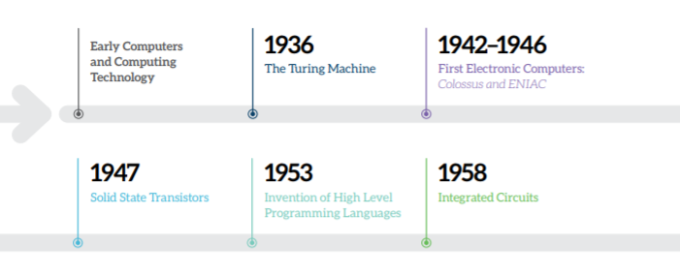
100 years of Computing Developments

Slide 3
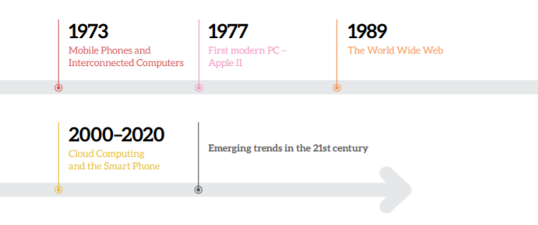

Slide 4
https://www.youtube.com/watch?v=O5nskjZ_GoI

Slide 5
Important Developments
Early 19th Century
Analytical Engine - Charles Babbage’s general purpose machine.
Ada Lovelace published the first algorithm intended for a computer.

Slide 6
Important Developments
19th Century
Telegraph and telephone were invented
Maxwell predicted radio wave to exist and published laws of electromagnetism resulting in Marconi’s transmission of radio waves across the Atlantic in 1901.

Slide 7
Important Developments
1920’s
Automobiles become affordable
Modern Electronic TV invented
Communication and travel revolutionised
Information revolution about to begin.

